Slide 1

Flight Management System
Streamlining Aviation Operations with Java
Presented by: Chirag Sedhai Rahul Shrestha Sunil Kumar Yadav

Slide 2

Why Automation in Aviation?
Traditional Challenges
Growing Demands
Automation: A Necessity
Manual processes led to delays, data inconsistencies, and high costs.
Increased air travel requires faster, more reliable systems.
Essential for efficient flight management operations.

Slide 3
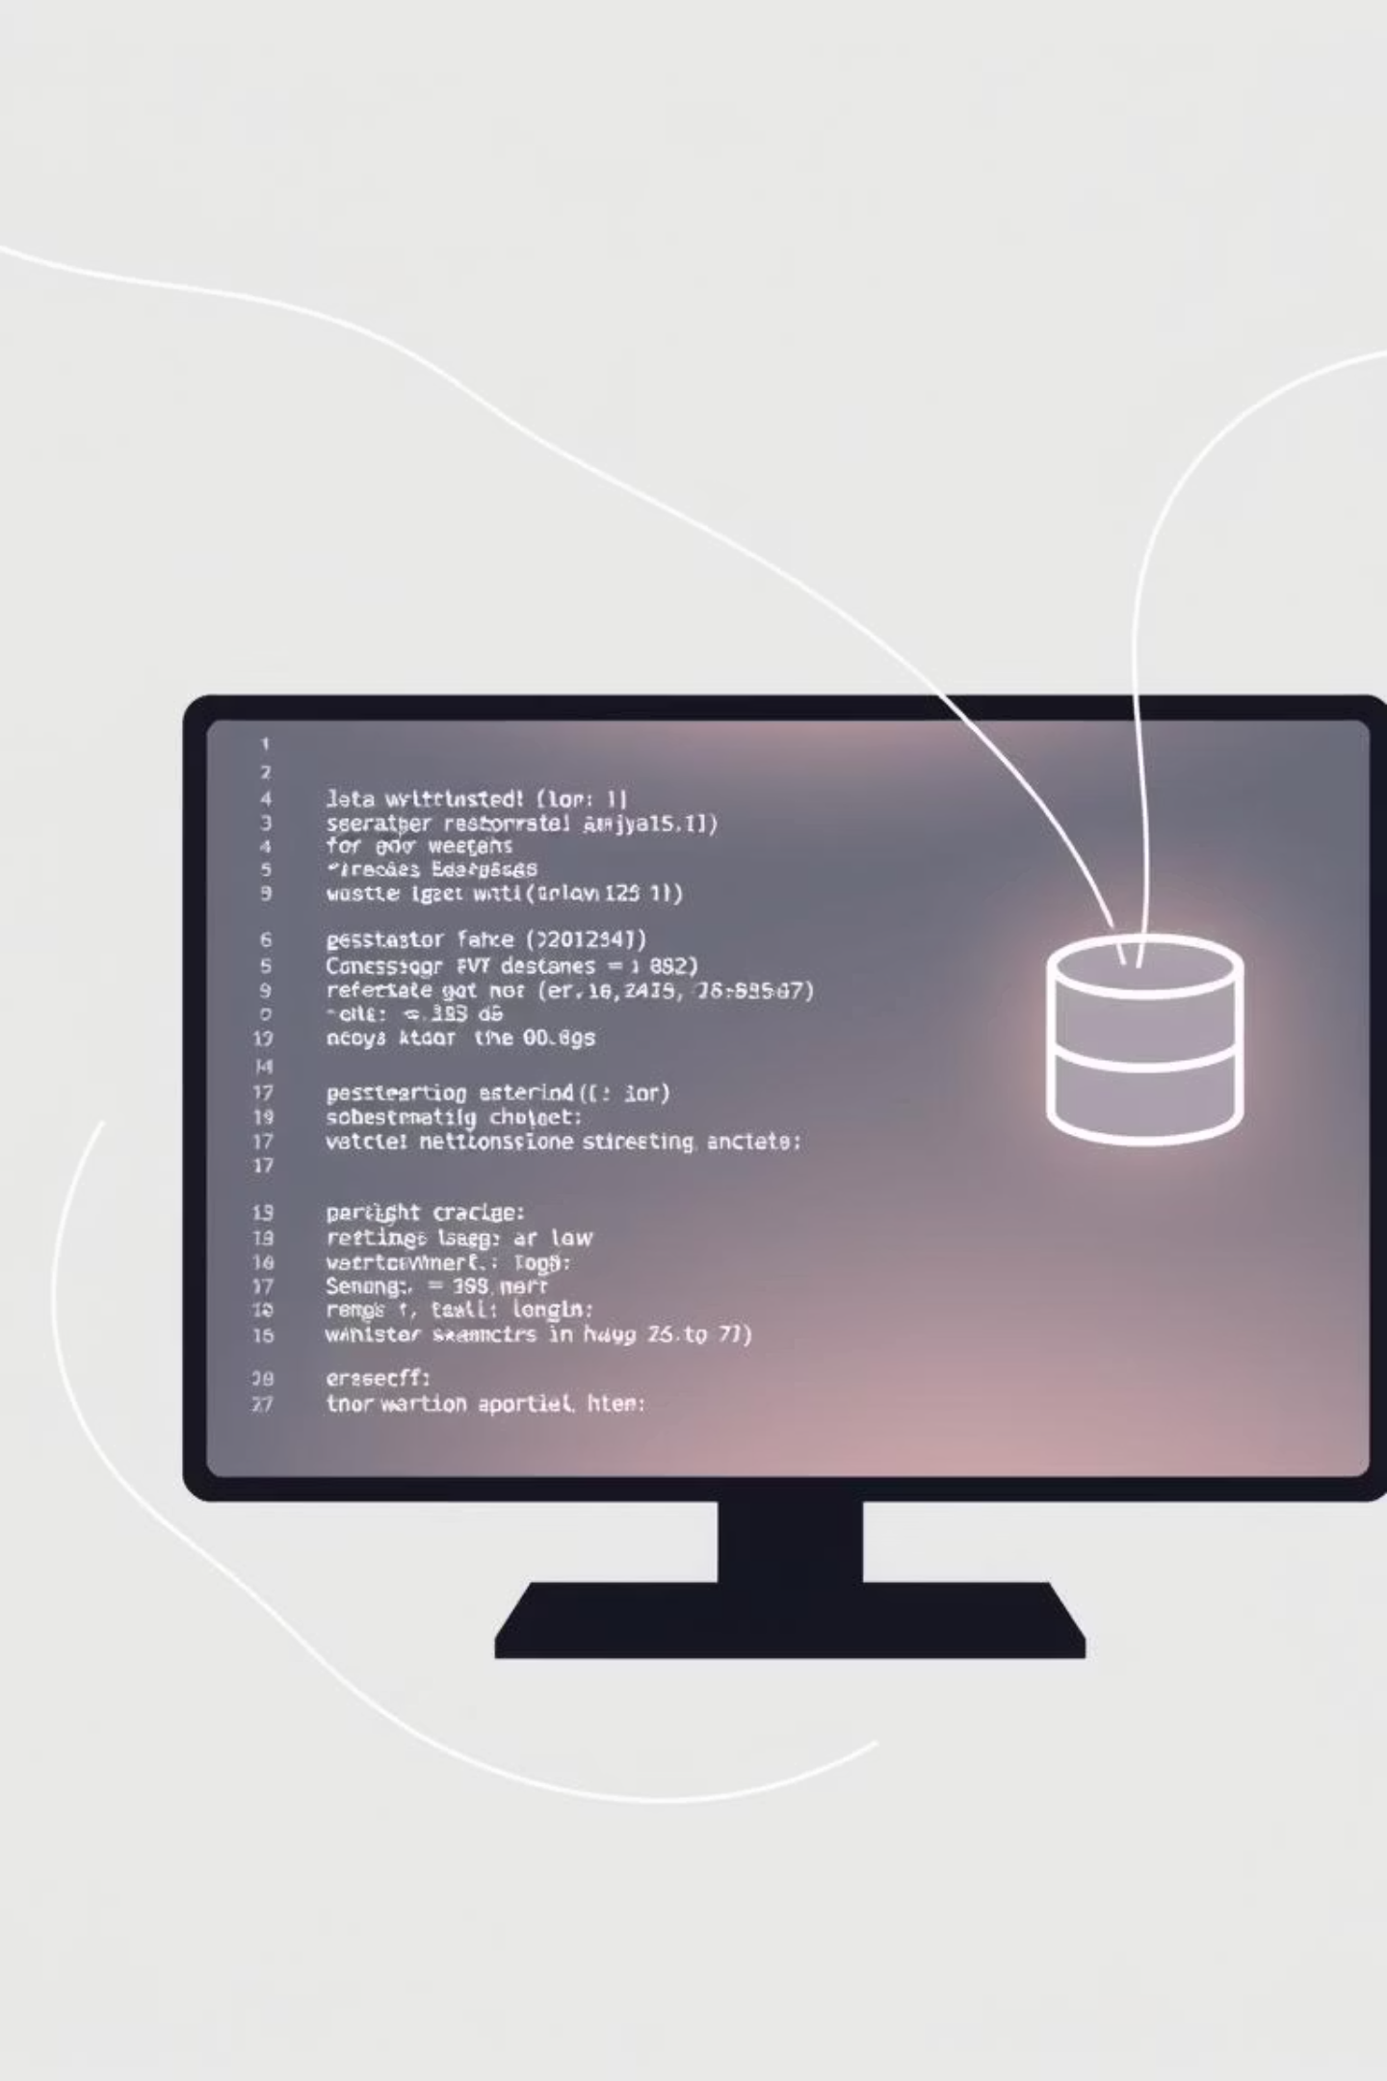



The Java Advantage
Platform Independent
Runs on various operating systems.
Strong Security
Robust features protect sensitive data.
Object-Oriented
Enables scalable, modular, and maintainable systems.

Slide 4


Problem & Objectives
Problem Statement
Main Objective
Inefficient manual processes, prone to errors and poor security. Need for reliable, automated system.
Develop a Java-based FMS to automate scheduling, passenger management, and booking. Reduce workload, improve accuracy.

Slide 5
System Scope
Flight Management
1
Schedules & details.
Passenger Info
2
Storage & management.
Booking & Cancellation
3
Efficient operations.
Role-Based Access
4
Admin & user roles.
Secure Database
5
Data storage.
User-Friendly
6
Smooth interaction.

Slide 6







System Limitations
No Real-time Tracking
Limited Scalability
No Online Payments
Basic Security
No External Integration
Hardware Dependent

Slide 7


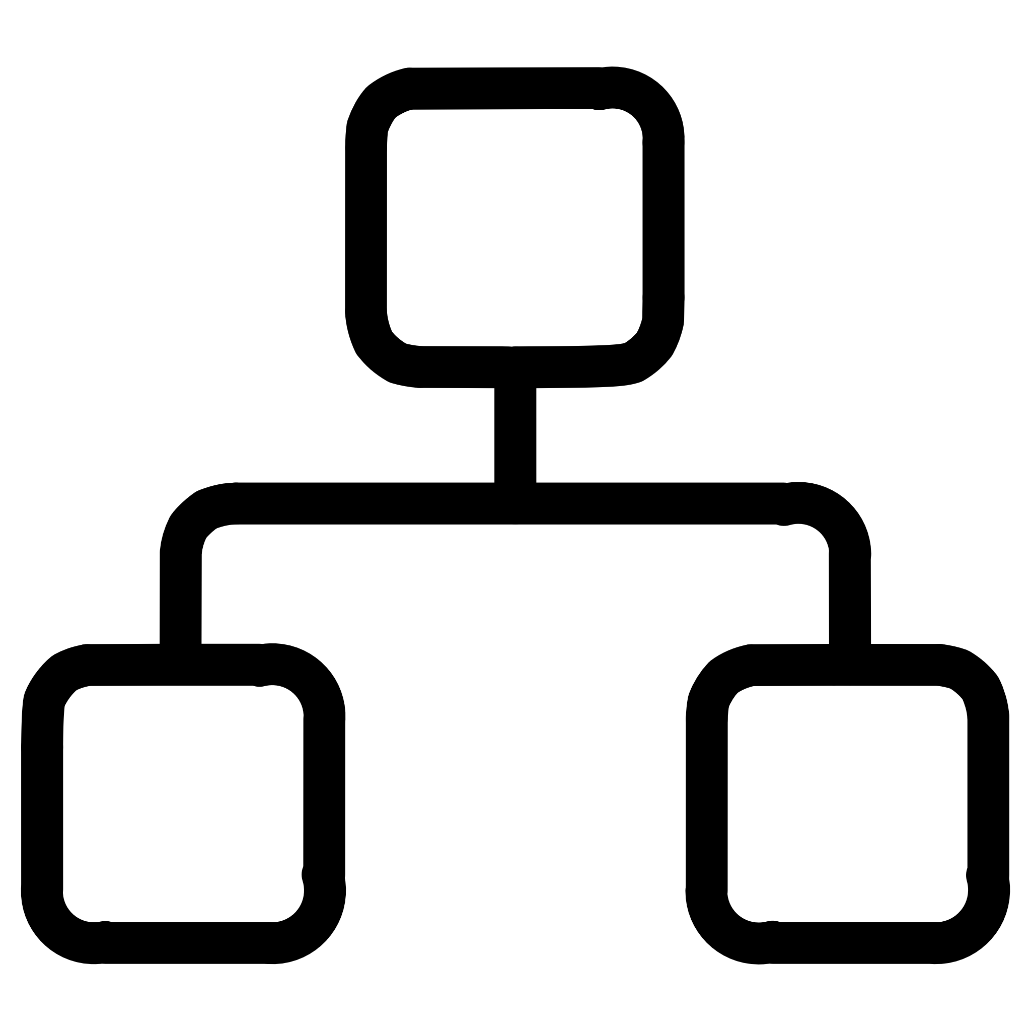






What's New in Our Project?
Structured Approach
OOP principles, centralized database.
Role-Based Access
Enhanced security & usability.
Cohesive Platform
Combines flight, passenger, booking.
Modular Design
Maintainable, extensible.

Slide 8
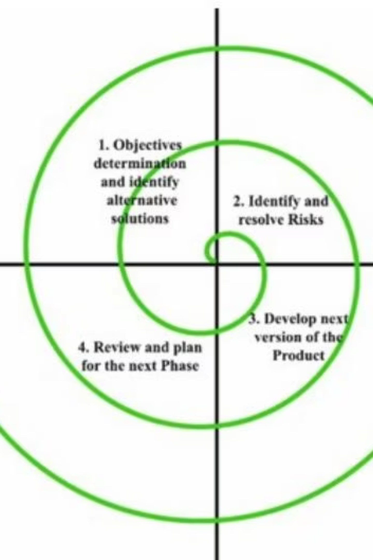
SDLC: Spiral Model
Iterative and risk-driven approach for robust development.
01
Planning
Define scope, objectives, resources.
02
Risk Analysis
Identify and mitigate potential issues.
03
Design & Implementation
Develop and refine system features.
04
Evaluation
Review and plan next iteration.

Slide 9
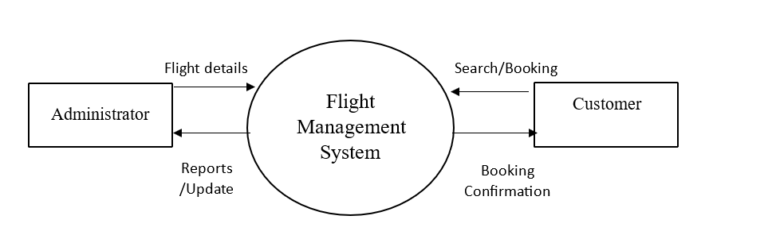
Context Diagram

Slide 10
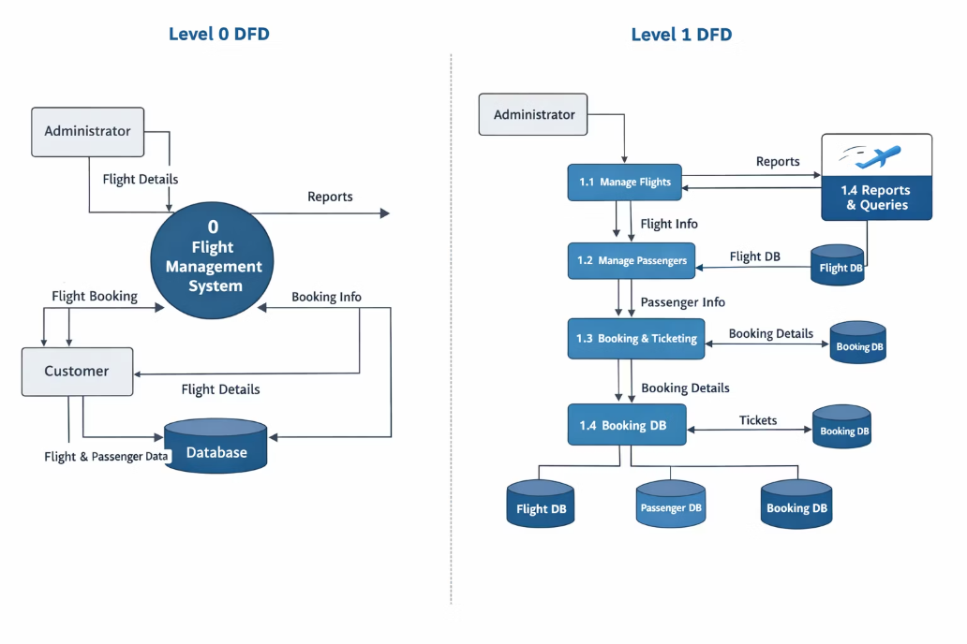
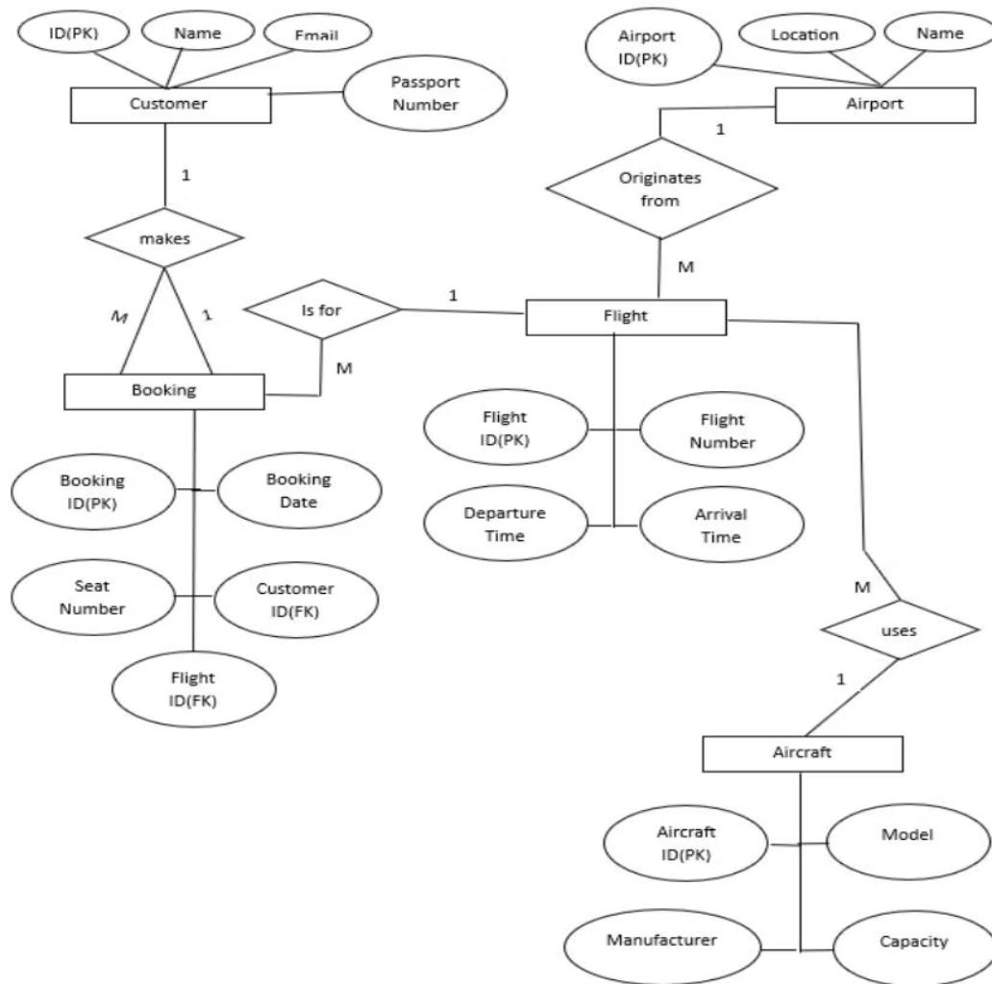
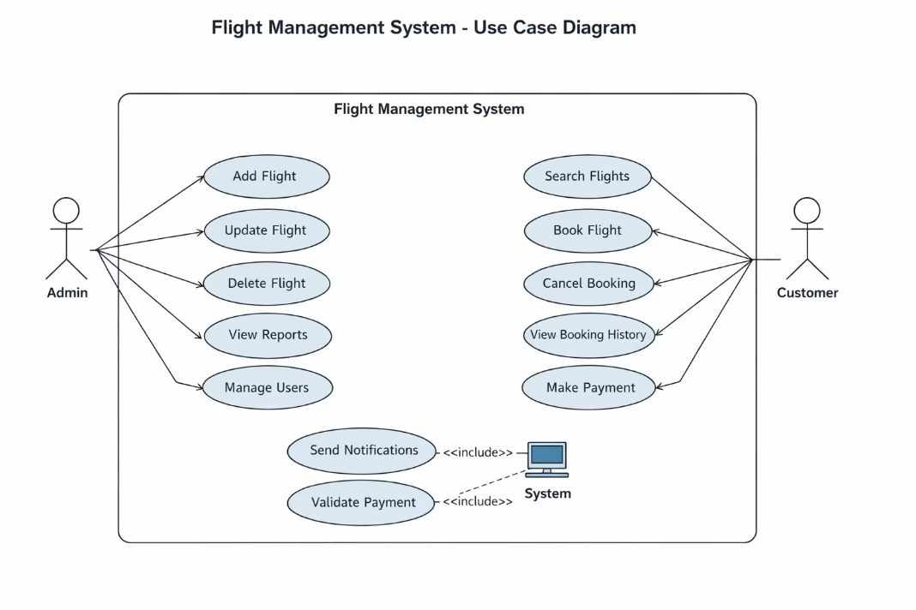
System Diagrams
DFD
ER Diagram
Use Case Diagram
Shows data flow between processes, data stores, and external entities.
Illustrates system actors and their interactions.
Visualizes database entity relationships.

Slide 11







Future Enhancements
Online Payment
Mobile App
Real-time Updates
Seat Selection
Notifications
Multi-language
Advanced Reporting

